Slide 1

Just In Time Detection of Unknown Classes Using Deep Learning
Team Members : Vazgen & Akshat
Adviser : Abu Islam
Notes:
Hi Everyone

Slide 2
Work for Current sprint
Finding optimal Threshold score
Generating embeddings for faster prediction time
Comparing the contrastive loss with triplet loss
Check model performance on Rotated Images
Notes:
Our goals in current sprint was Generating Embedding to accelerate prediction time
Improve our Triplet Network and compare its results with contrastive loss Come up with idea to set optimal Threshold.
Last but not least check model's robustness on Rotated Images.
We were able to complete all the task listed here.

Slide 3
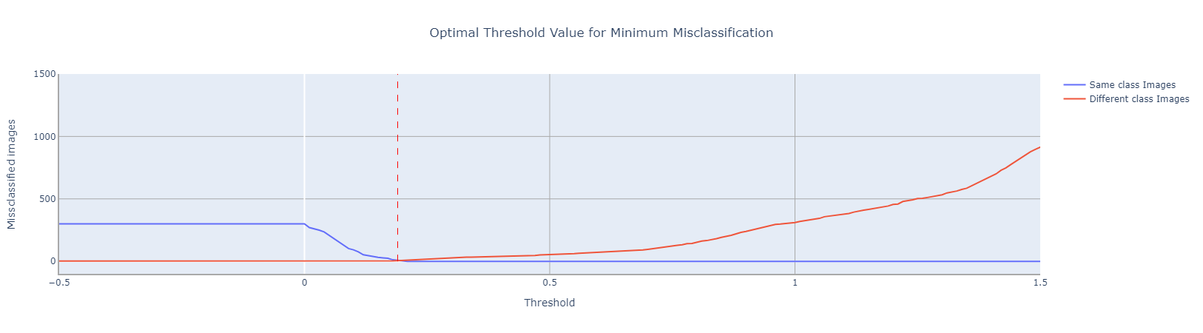
optimal threshold Score
Blue line represents image belonging in same class being classified as different class
Red line represents image belonging in different class being classified as same class
Found optimal threshold score by taking intersection of both line
Fig 1: Optimal Threshold Value for Minimum Misclassification, found at threshold = 0.19
Notes:
In our research to determine the optimal threshold score, we devised the following solution. We plotted the number of images belonging to the same class but misclassified as different classes, and vice versa, for various thresholds ranging from -0.5 to 1.5. At this stage, it is equally important for us to address both metrics. Therefore, we chose the point where the two lines intersect, as this is where the two lines are closest to their global minimum.

Slide 4
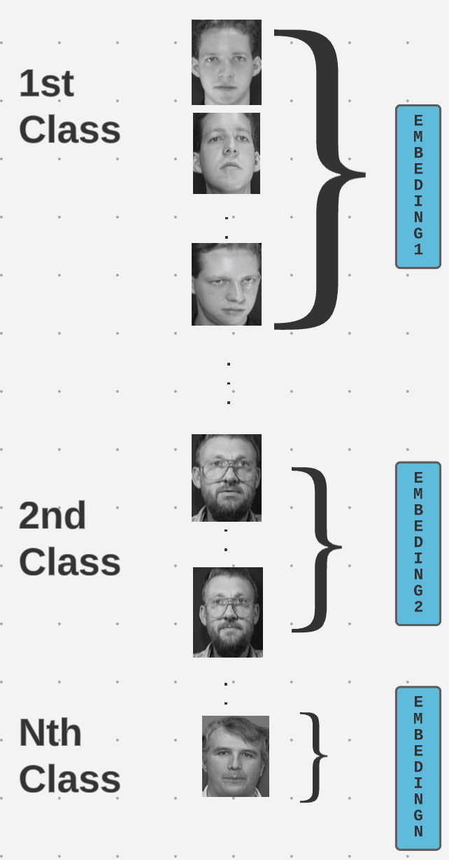
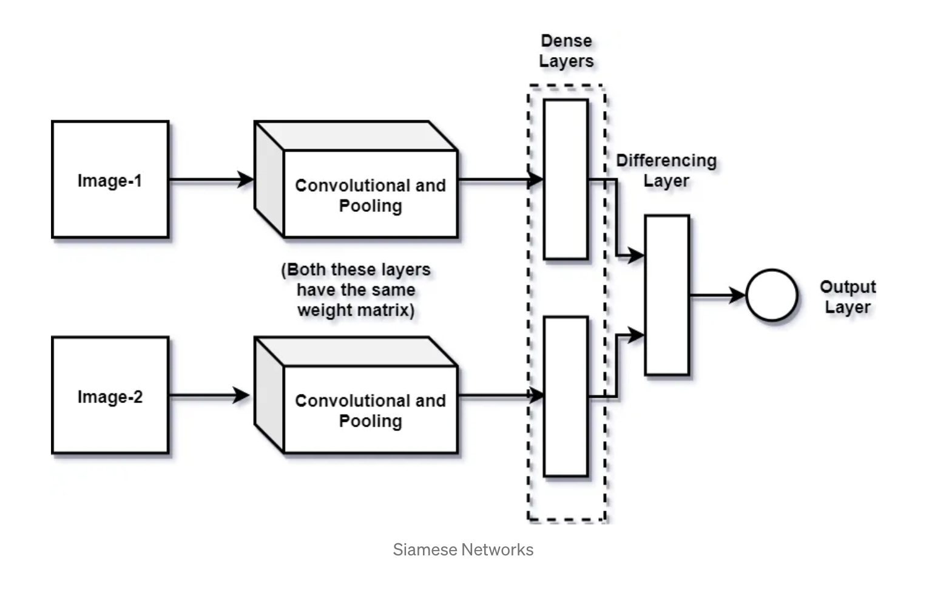
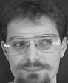
PROTOTYPE EMBEDDING
Test Image
Fig 2: Siamese Network
We get a mean embedding for each class
Resulting in n comparison instead of m*n comparison
Fig 3: Prototype Embedding of n classes, where each class has m images.
Notes:
Lets talk about prototyping embeddings. After training our model, we store the image representation of each image as a 128-dimensional vector. In N-way shot learning, this set is known as the Support Set. When a new test image comes in for prediction (referred to as the Query Set), its representation is compared against all the training image vectors. If the minimum distance between the test image and a training image meets our threshold, we classify it accordingly. If it doesn't meet the threshold, the image is considered unknown.
However, when dealing with a large dataset, these comparisons can be time-consuming. To overcome this, we use a prototype embedding approach. We calculate the mean of the embeddings for each class, resulting in N prototypes. Now, a query set image only needs to be compared with N prototypes rather than all n times m images, where m is the number of images in each class. While this may slightly decrease accuracy, it significantly improves performance as we will see in the next slide.

Slide 5
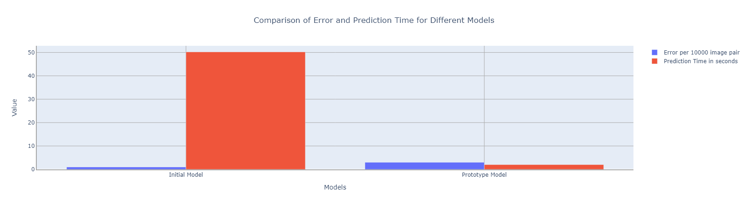
Prototype embedding Results
Used mean prototype embedding technique
Improvement in prediction time by 25 times than conventional methods
Fig 4: Comparison of Error and Prediction Time for Different Models
Notes:
Here you can see the results before and after implementing the prototype approach. The blue bar represents the number of errors per 10000 images, while the red bar indicates the prediction time in seconds. Although the error rate has slightly increased, we have significantly accelerated prediction time by 25 times.

Slide 6
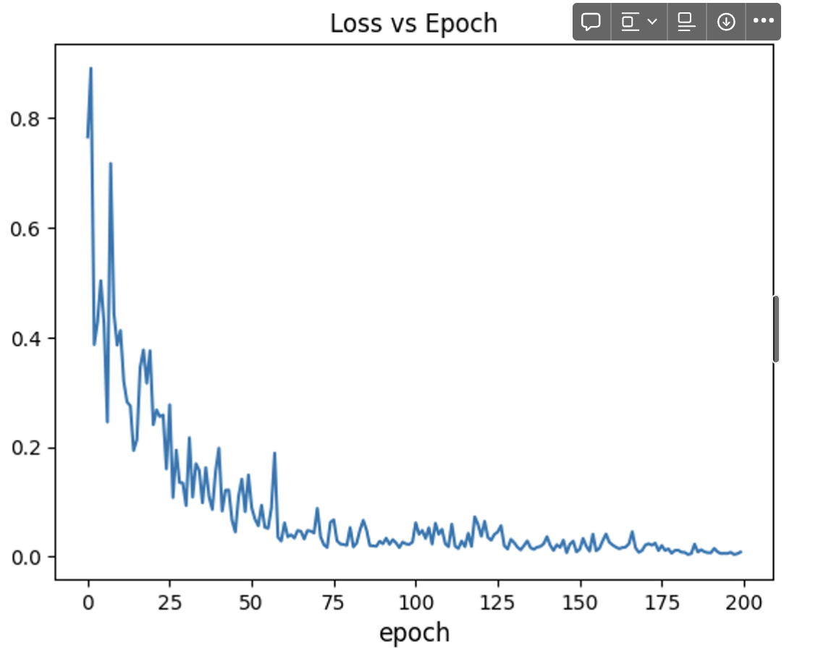
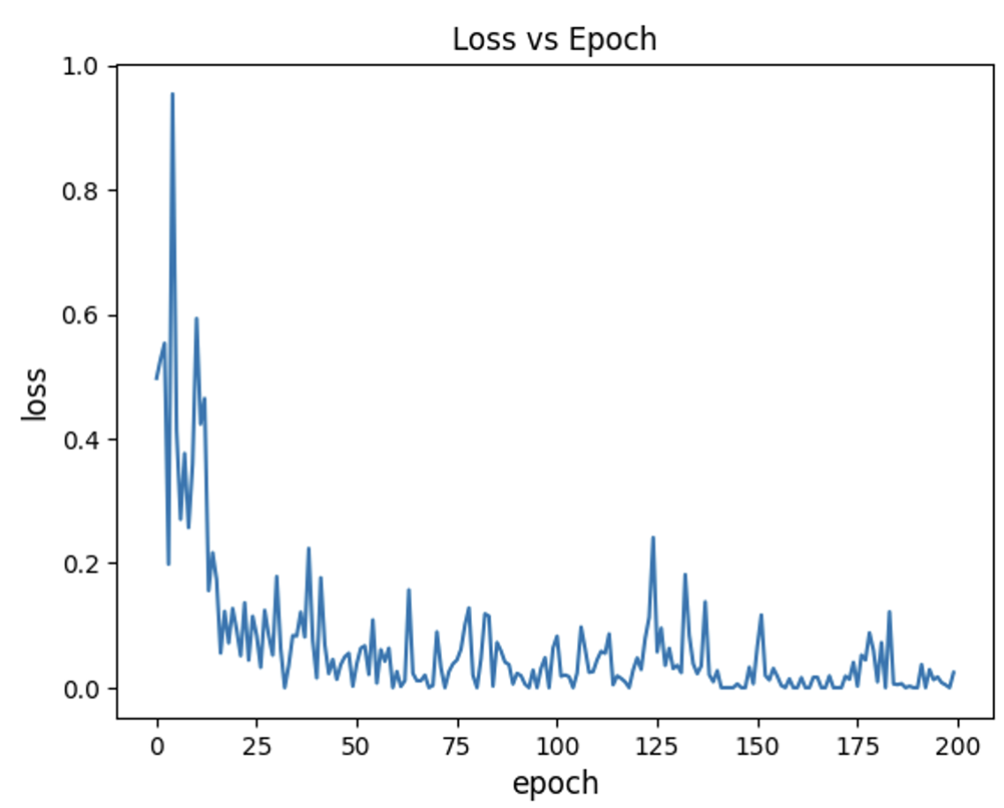
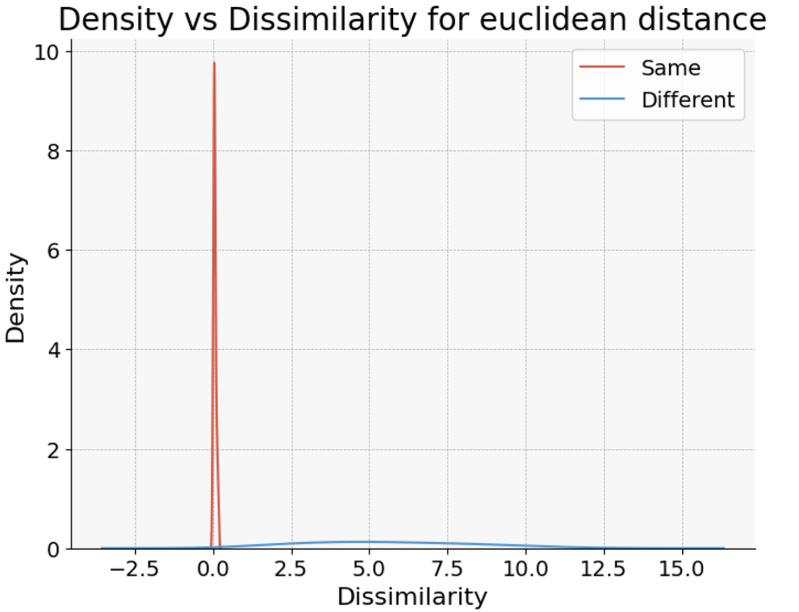
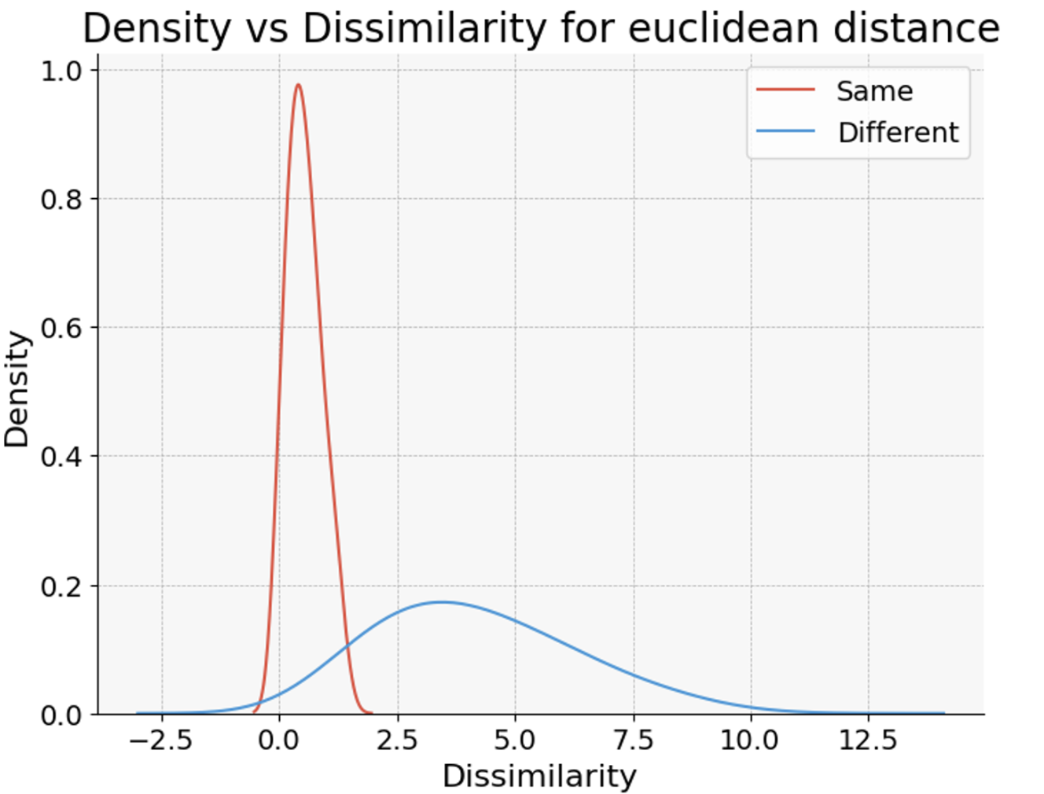
Results on Triplet loss vs contrastive loss
Contrastive Loss
Triplet Loss
Fig 5 (a)
Fig 5 (b)
Fig 5: Results of Loss vs Epoch for (a) Contrastive Loss and (b) Triplet Loss
Fig 6: Number of Intersection for (a) Contrastive Loss and (b) Triplet Loss
Fig 6 (a)
Fig 6 (b)
Notes:
In the last sprint, our triplet model was overfitting the training data. We managed to address this issue by generating better triplets during training. However, Contrastive loss still outperforms Triplet loss in terms of smoother loss convergence and a reduced number of intersections. Therefore, we will proceed using only Contrastive loss from now on.

Slide 7
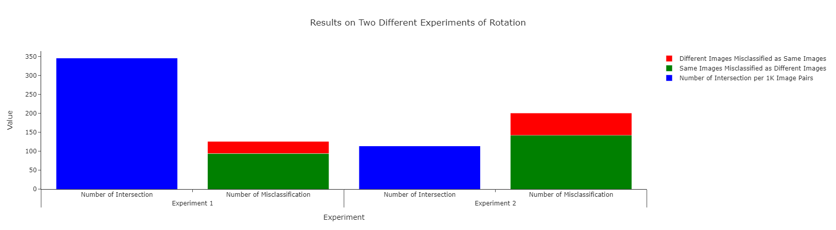
Effects of Rotated images
‘Experiment 1’ -> Only test images rotated
‘Experiment 2’ -> Trained also on rotated images and tested on rotated images
Having rotated images improved performance of model in terms of intersection.
Fig 7: Results on Two Different Experiments of Rotation
Notes:
We aimed to evaluate the model's performance on rotated images and conducted two distinct experiments. Firstly, we assessed the model's performance on test images containing rotated samples while keeping original training dataset. Next, we explored the potential improvements when randomly rotating training images. As a result, we observed a decrease in the number of intersections, but there was a limitation, as the number of misclassifications slightly increased. In future work, we will focus on developing better rotation techniques to address this issue.

Slide 8
Thank you
Notes:
Thank you everyone

